Slide 1


Image Analysis of Photovoltaic Modules(PVM) based on Computer Vision and Deep Learning
Core R&D: Bingru Xin , Yang Liu, Yan Ma
Acknowledgement: Frank Gong, Wuye Ouyang,
Jingqi Wang, Tingting Chen, Ce Xi
08/20/2024

Slide 2
Self-Introduction
Project Background
Project Progress
Summary & Outlook

Slide 3




Self-introduction
Apr. 2024 – Oct. 2024
Core R&D E&PS Intern, SDC, Shanghai
Sep. 2022 – Jun. 2025 (Expected)
Master of Chemical Engineering (Direction：Process Systems Engineering)
Sichuan University (四川大学, SCU), School of Chemical Engineering
Bingru XIN
辛炳儒
Sep. 2018 – Jun. 2022
Bachelor of Process Equipment & Control Engineering
Sichuan University(四川大学, SCU), School of Chemical Engineering

Slide 4
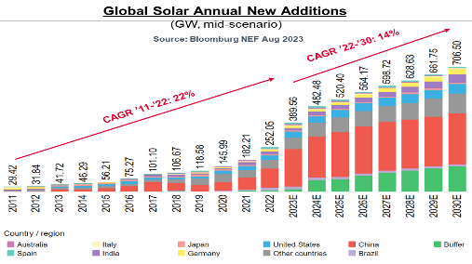
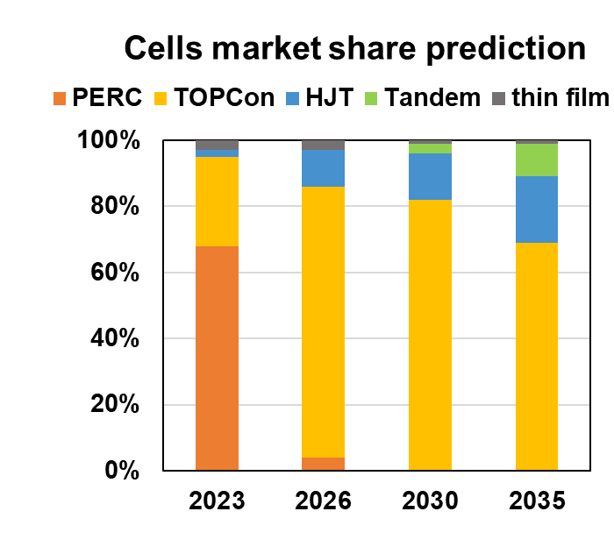
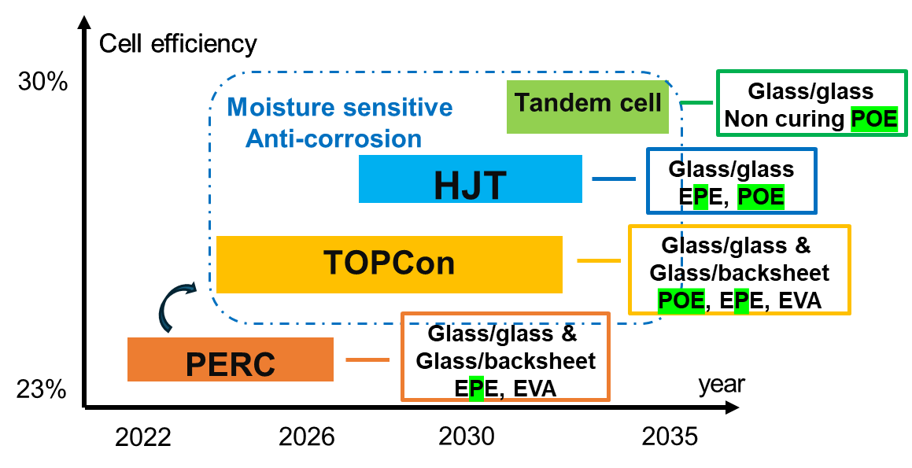
Market dynamic: film requirement
Tandem
HJT
TOPCon
Energy structure transformation
Global new solar power installation to continue double digit growth driven by energy structure transformation.
Develop robust POE film to extended the service life of PVM.
Break the limitations to promote potential advantages of POE over EVA/EPE.
Encapsulant
Solar cell
Backsheet or glass
Fingers
PbO based borosilicate glass
Solar Energy Materials and Solar Cells, 2021, 230: 111296.

Slide 5
Technical needs
Why is DOW's POE better than other material companies?
Because PVM using Dow's POE will have a longer service life.
Imaging and image analysis technology

Slide 6
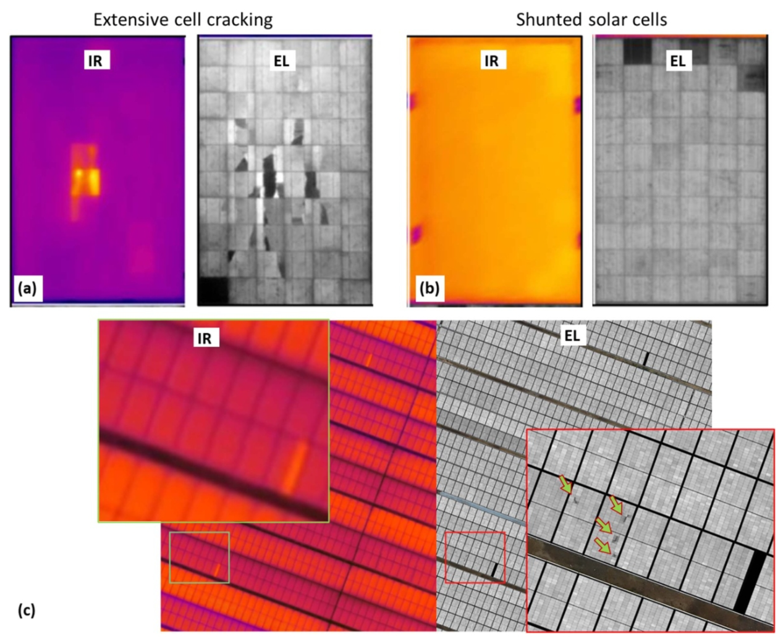
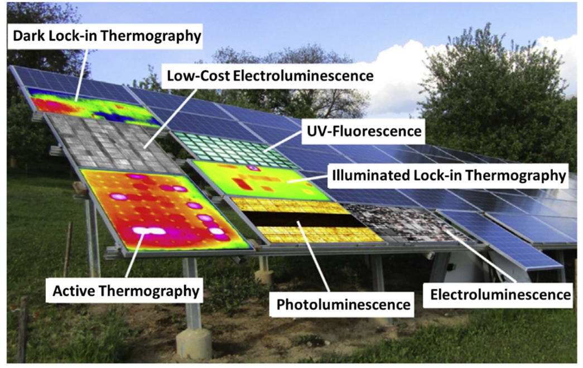
Electroluminescence(EL)-PV Imaging
Various imaging-based methods for PVM: IR, PL, EL(high/low-cost), et al.
EL reveals more failures than IR due to EL images’ higher sensitivity and resolution.
Progress in Energy, 2022, 4(4): 042014.

Slide 7
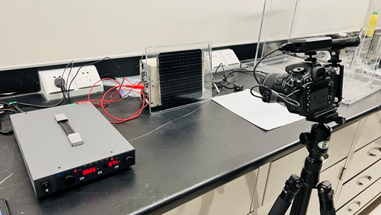
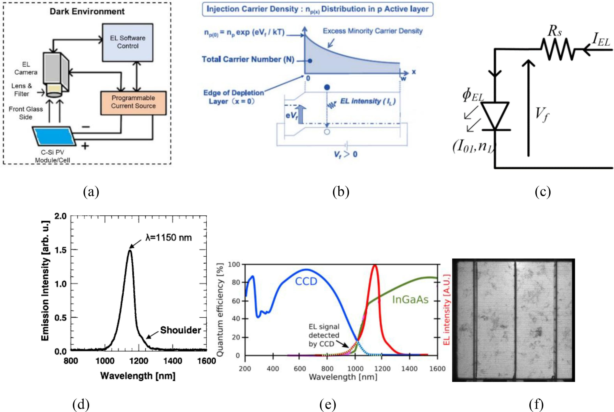
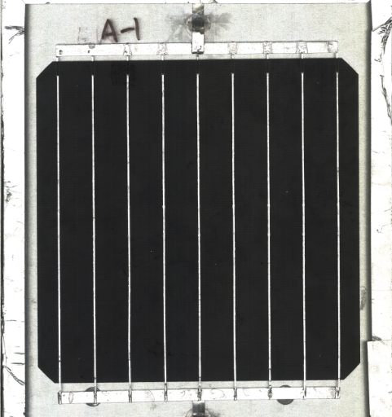
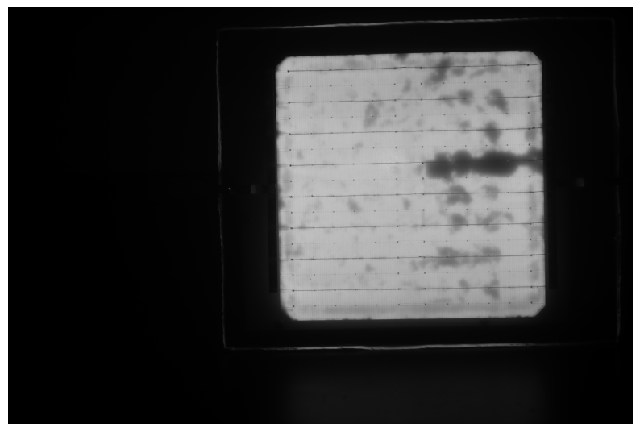
Electroluminescence(EL)-based imaging for photovoltaic cells
Block diagram of indoor EL set up
Mechanism of EL emission
Photovoltaic(PV) cell
EL-PV Image (lab)

Slide 8
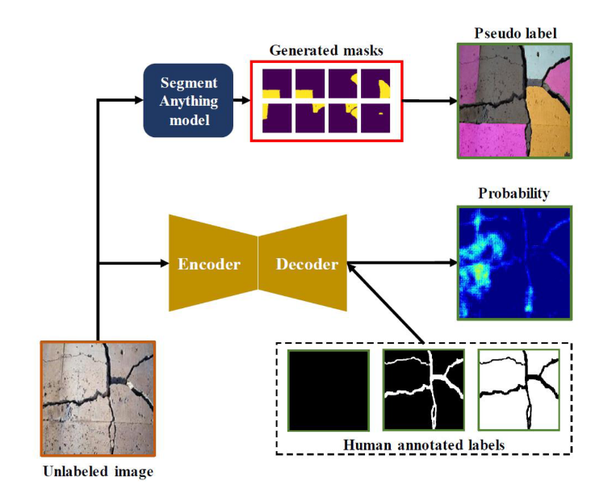
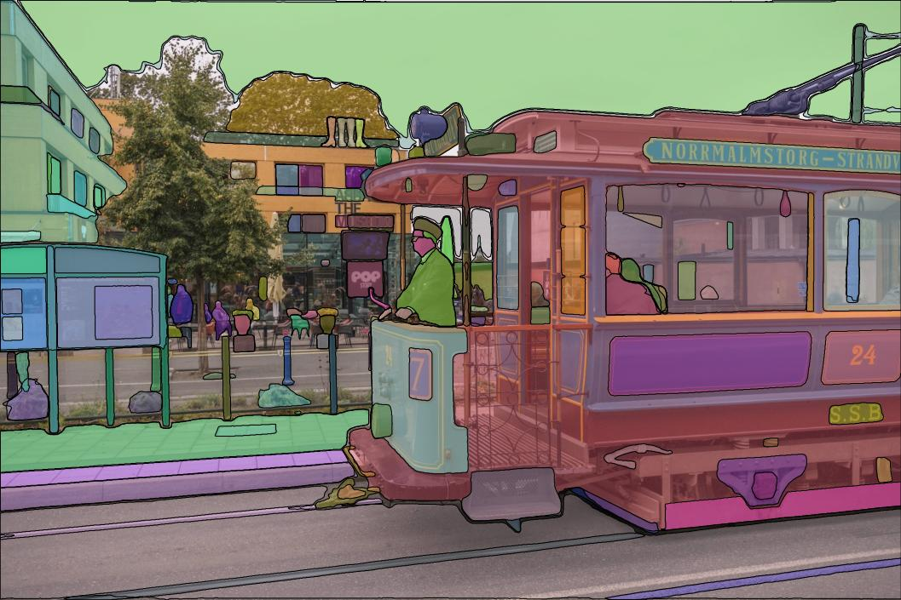
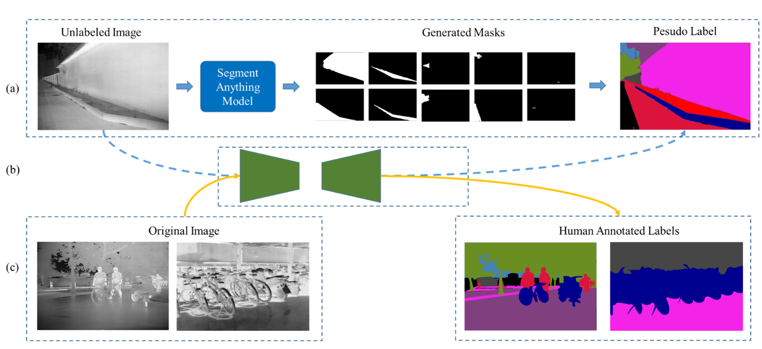
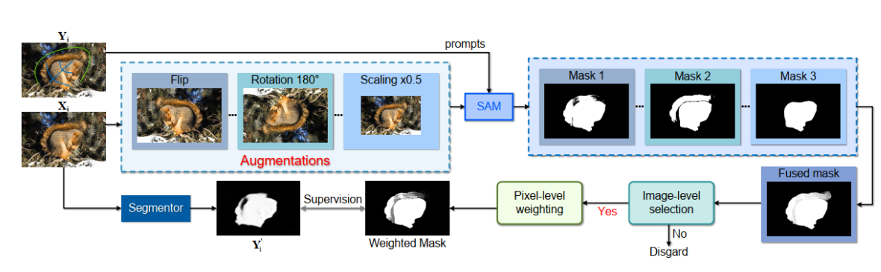

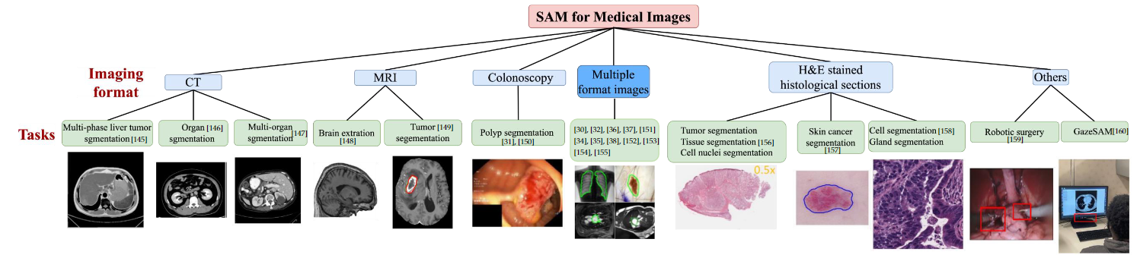
Highlight: Segment Anything Model(SAM) in industry
Segment Anything Model (SAM)
real-world object detection
generate pseudo labels to build dataset
Segment Anything Model(SAM):A BIG Pre-trained model which can unify the whole image segmentation task (NO NEED TRAINING).
The known industrial application scenarios of SAM: object detection, generate mask, medical image processing.
medical image processing and segmentation
Zhang C, Liu L, Cui Y, et al. A comprehensive survey on segment anything model for vision and beyond[J]. arXiv preprint arXiv:2305.08196, 2023.

Slide 9
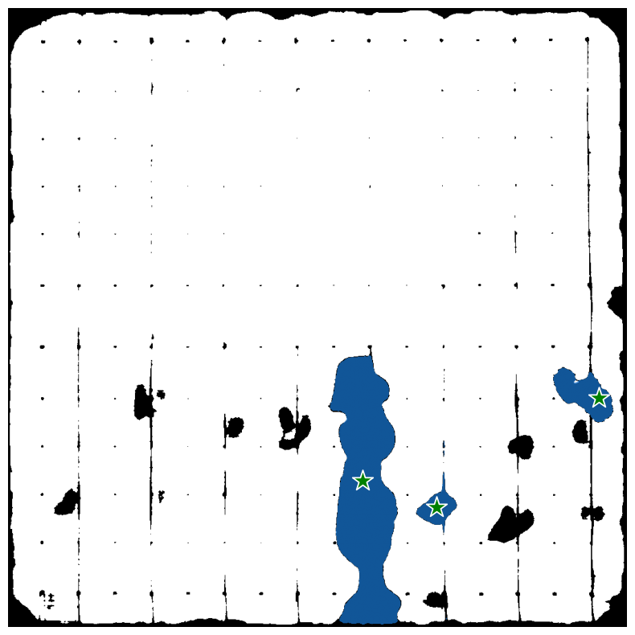

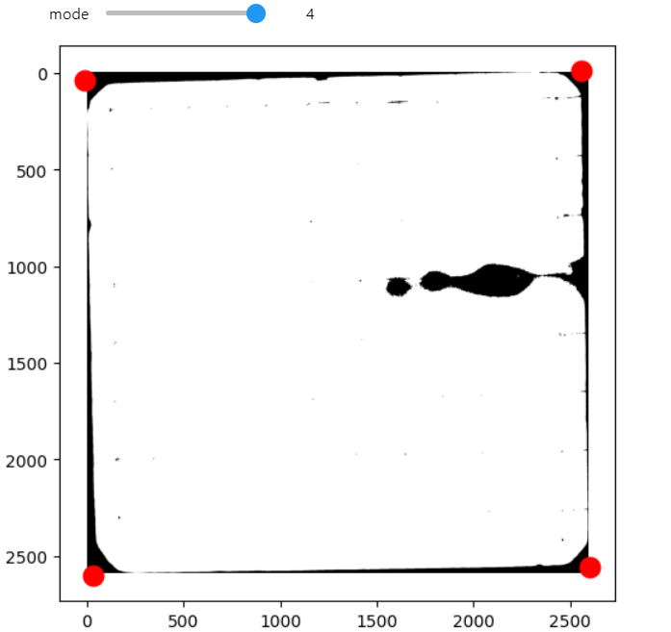
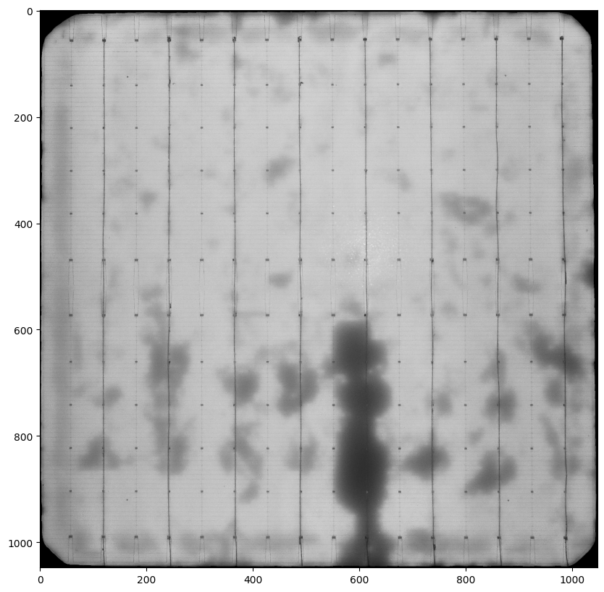
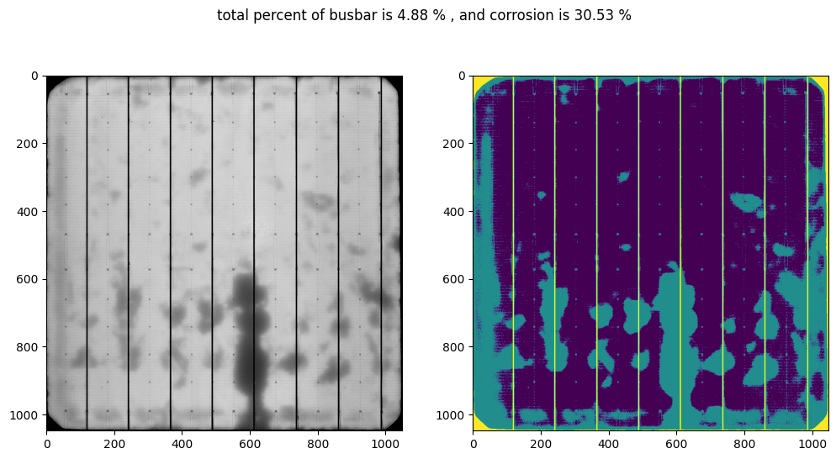
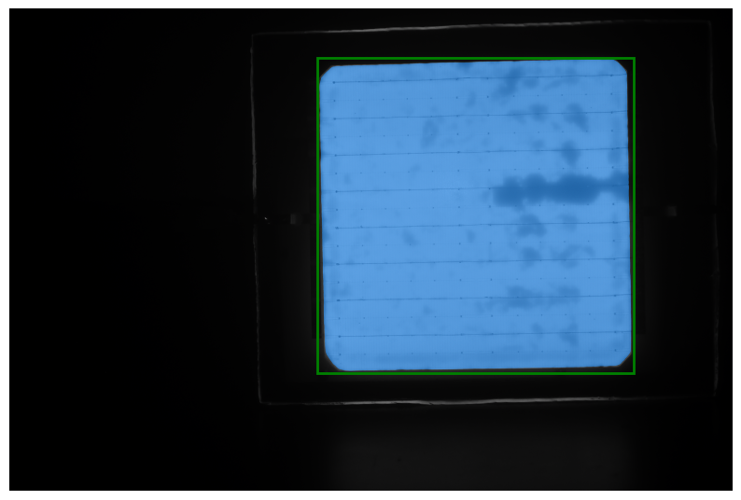
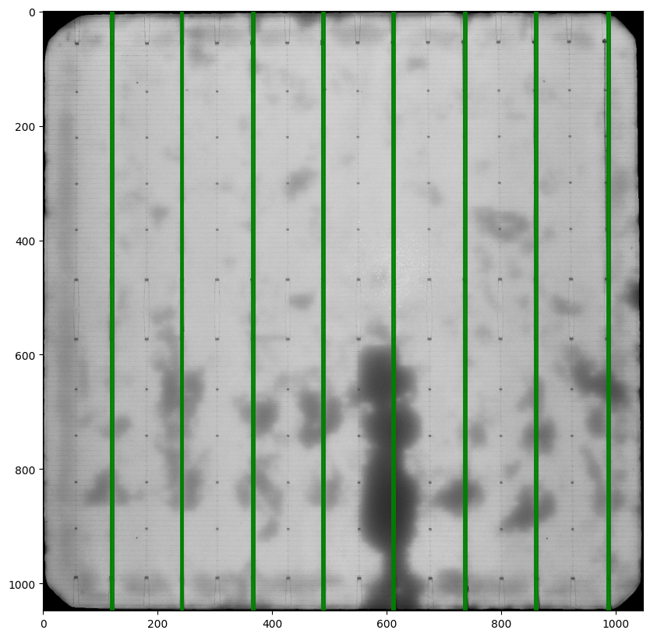

Automated Workflow: Deep Learning & Computer Vision-based
Find Corrosion
Box-based input
Point-based input
If need
Raw EL Image
SAM based on box input
Transform
(1024*1024)
Rotate 90°
Healthiness
Peak detection
Find busbar
CV methods-based transform

Slide 10
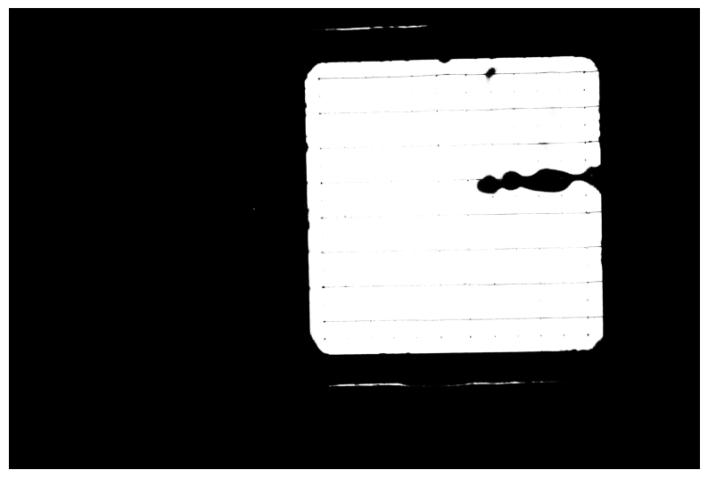
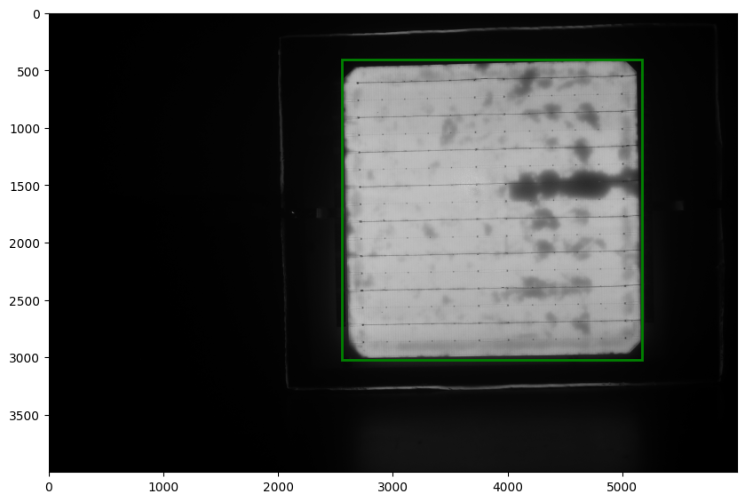
Step1: SAM based on automated box input
Raw EL Image
OTSU threshold
Box input
SAM based on box input
cv2.threshold(gray_img,0,255,cv2.THRESH_BINARY+cv2.THRESH_OTSU)
cv2.findContours()
max(contours, key=cv2.contourArea)
x, y, w, h = cv2.boundingRect(max_contour)
box = [x - 10, y - 10 , x + w + 5, y + h + 5]
SAM box input is: [ 2556, 405, 5175, 3023 ]

Slide 11
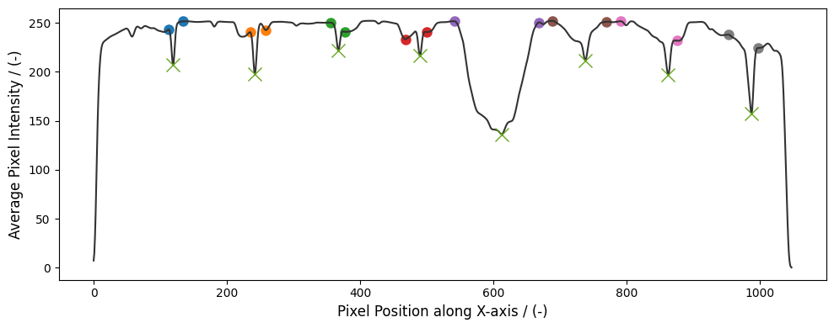
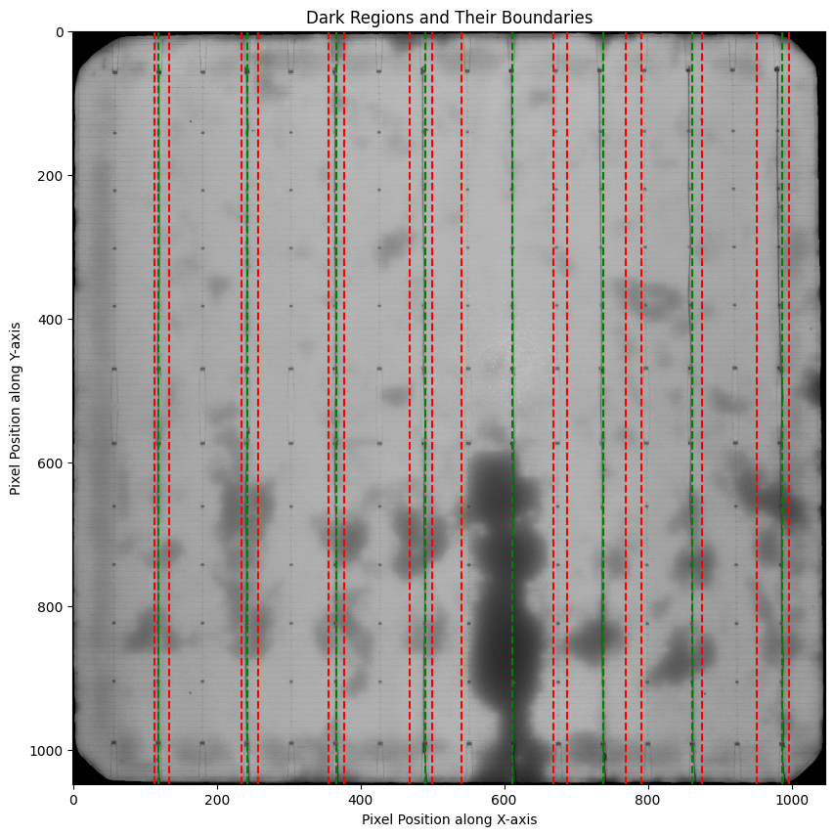
Step2: Calculation model of Busbar
Plot the average pixel distribution on the x-axis.
Find busbar based on peak detection.
Starting from the peak, look left and right to find the pixel value of the first gradient change.

Slide 12
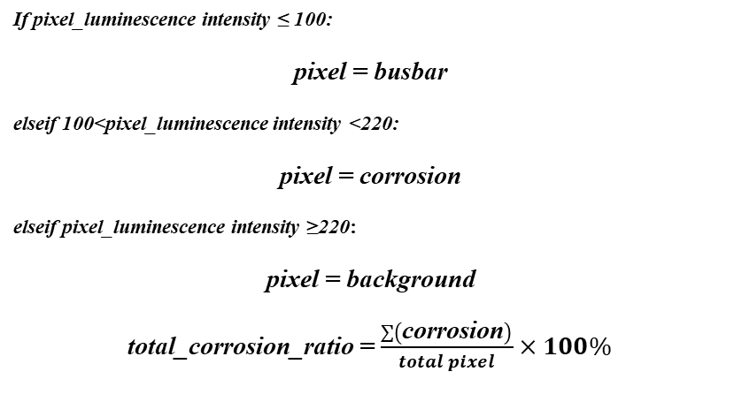
Step3: Global Healthiness of EL-PV image front
If pixel_luminescence intensity ≤ 100:
pixel = busbar
elseif 100<pixel_luminescence intensity <220:
pixel = corrosion
elseif pixel_luminescence intensity ≥220:
pixel = background
total_corrosion_ratio = $\frac{\sum{\left(\text{corrosion}\right)}}{total pixel}×100\%$
Total percent of busbar is 4.88%, and corrosion is 30.53%
Corrosion
Good part
Busbar
Background

Slide 13
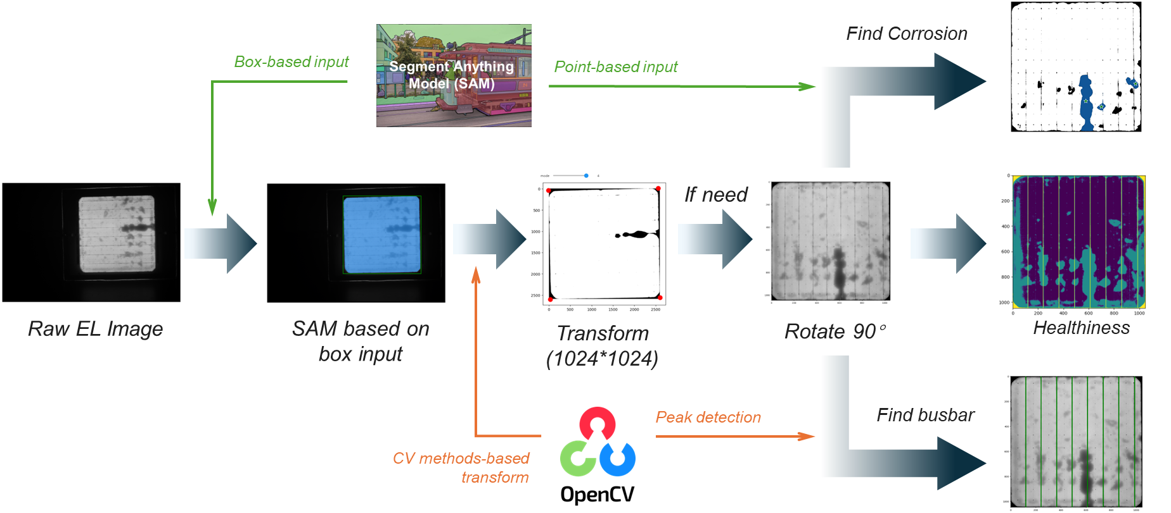
Summary
We developed an algorithm to automatically transform, locate, and perform busbar segmentation for calculation of total EL image luminescence intensity, corrosion ratio and corrosion on busbar.
An automated PV-EL image processing workflow based on SAM&CV.
Calculation model of corrosion along the busbar and global healthiness.
Busbar detection method based on Otsu threshold and peak detection.

Slide 14
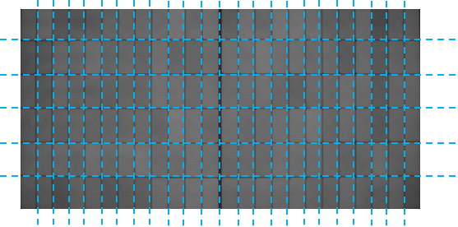
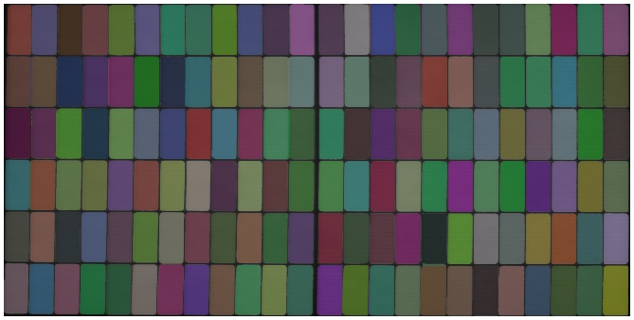
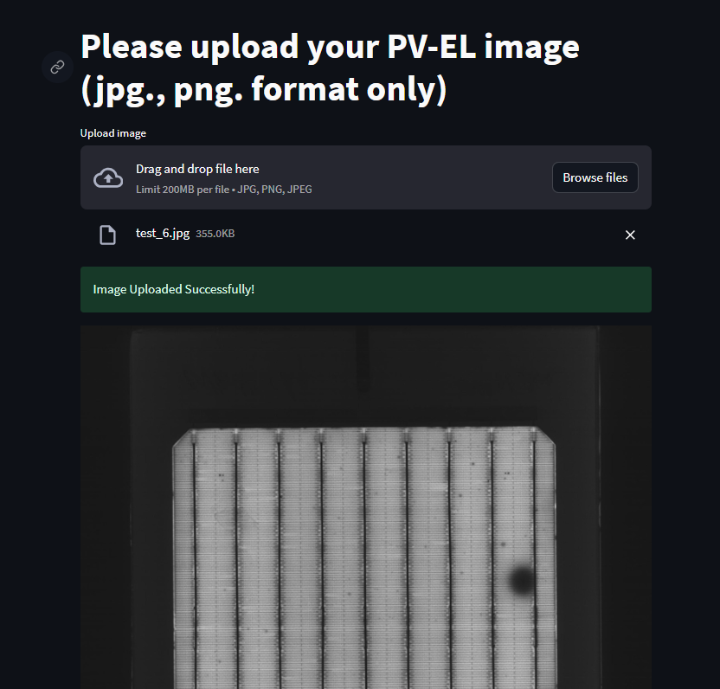
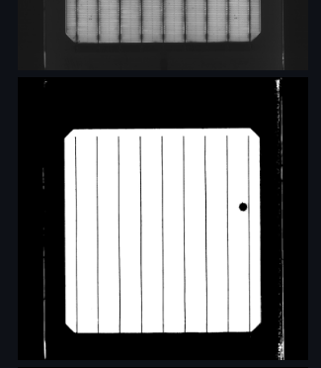
Future work
Field PV-EL image segmentation and analysis to bypass laborious process of IV test.
Code deployment for Lab and Field image to output PV battery performance indicator based on image analysis.
Cell level (lab) input :
Fundamental understanding on PV module failure analysis.
Module level (field) input :
Segment field image.
Predictive modeling to shorten field testing.

Slide 15
Acknowledgement
Project mentor
Liu, Yang
Ma, Yan
Team Leader
Gong, Frank
Ouyang, Wuye
Other E&PS Members
Chen, Tingting
Wang, Jingqi
Xi, Ce

Slide 16
Image Analysis of Photovoltaic Modules(PVM) based on Computer Vision and Deep Learning
Thanks For Your Attention!
Core R&D: Bingru Xin , Yang Liu, Yan Ma
Acknowledgement: Frank Gong, Wuye Ouyang,
Jingqi Wang, Tingting Chen, Ce Xi
08/20/2024

